Slide 1


Software Design & System Design
Databases
Otávio Santana, Founder
otavio@os.expert

Slide 2
Introduction
Topics on this class
SQL
NoSQL
NewSQL
CAP / PACELC
ETL (Extract, Transform, Load)
ELT (Extract, Load, Transform)
Data warehousing and data lakes

Slide 3
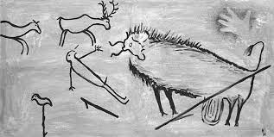

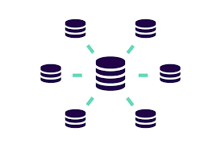
Database evolutions
Notes:
No mundo das apps, existe vasta base de conhecimento porém com dbs já não é assim.

Slide 4
It's where the state is
Why Do Modern Applications
Need Data Storage?
The current opportunity
The new opportunities
Notes:
No mundo das apps, existe vasta base de conhecimento porém com dbs já não é assim.

Slide 5
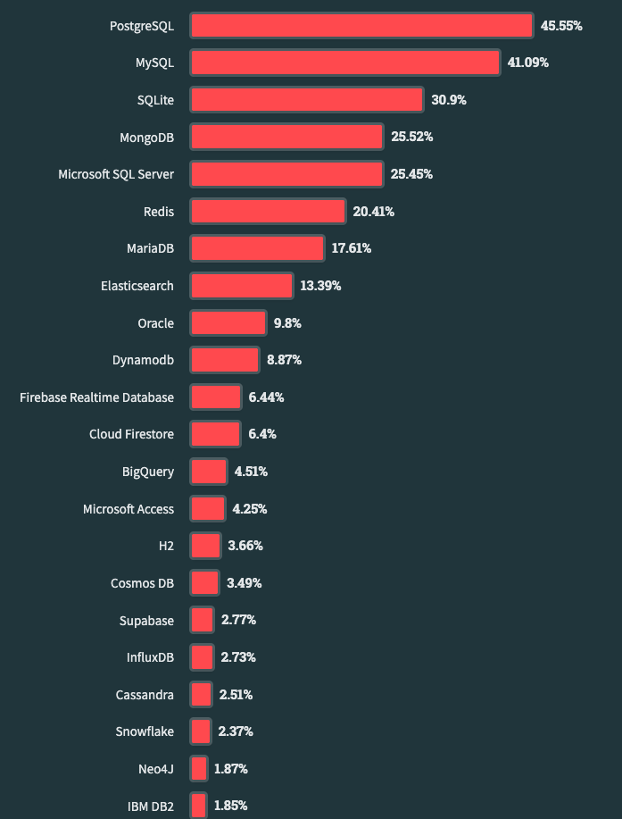



Persistence landscape
State of affairs
Maturity Model
Paradigms
Database flavors
https://survey.stackoverflow.co/2023/
Notes:
https://ourworldindata.org/grapher/historical-cost-of-computer-memory-and-storage

Slide 6
Database solutions
Polyglot Persistence
SQL Database
NoSQL Database
Wide-Column
Graph
Document
Key Value
key
value
key
value
key
value
key
value
Notes:
https://ourworldindata.org/grapher/historical-cost-of-computer-memory-and-storage

Slide 7
Key-value
Structure
Apollo
Sun
Key
Value
Ares
War
Love
Beauty
Aphrodite
Notes:
https://ourworldindata.org/grapher/historical-cost-of-computer-memory-and-storage

Slide 8

Redis
Use cases
Use Case | Description
Caching | Speeds up data retrieval by storing frequently accessed data in memory, reducing the need to fetch it from the backend.
Session Management | Stores and manages user sessions, enhancing application performance and scalability.
Real-time Analytics | Powers real-time dashboards and analytics by swiftly processing and aggregating data.
Pub/Sub Messaging | Facilitates real-time communication between components through publish-subscribe messaging patterns.

Slide 9
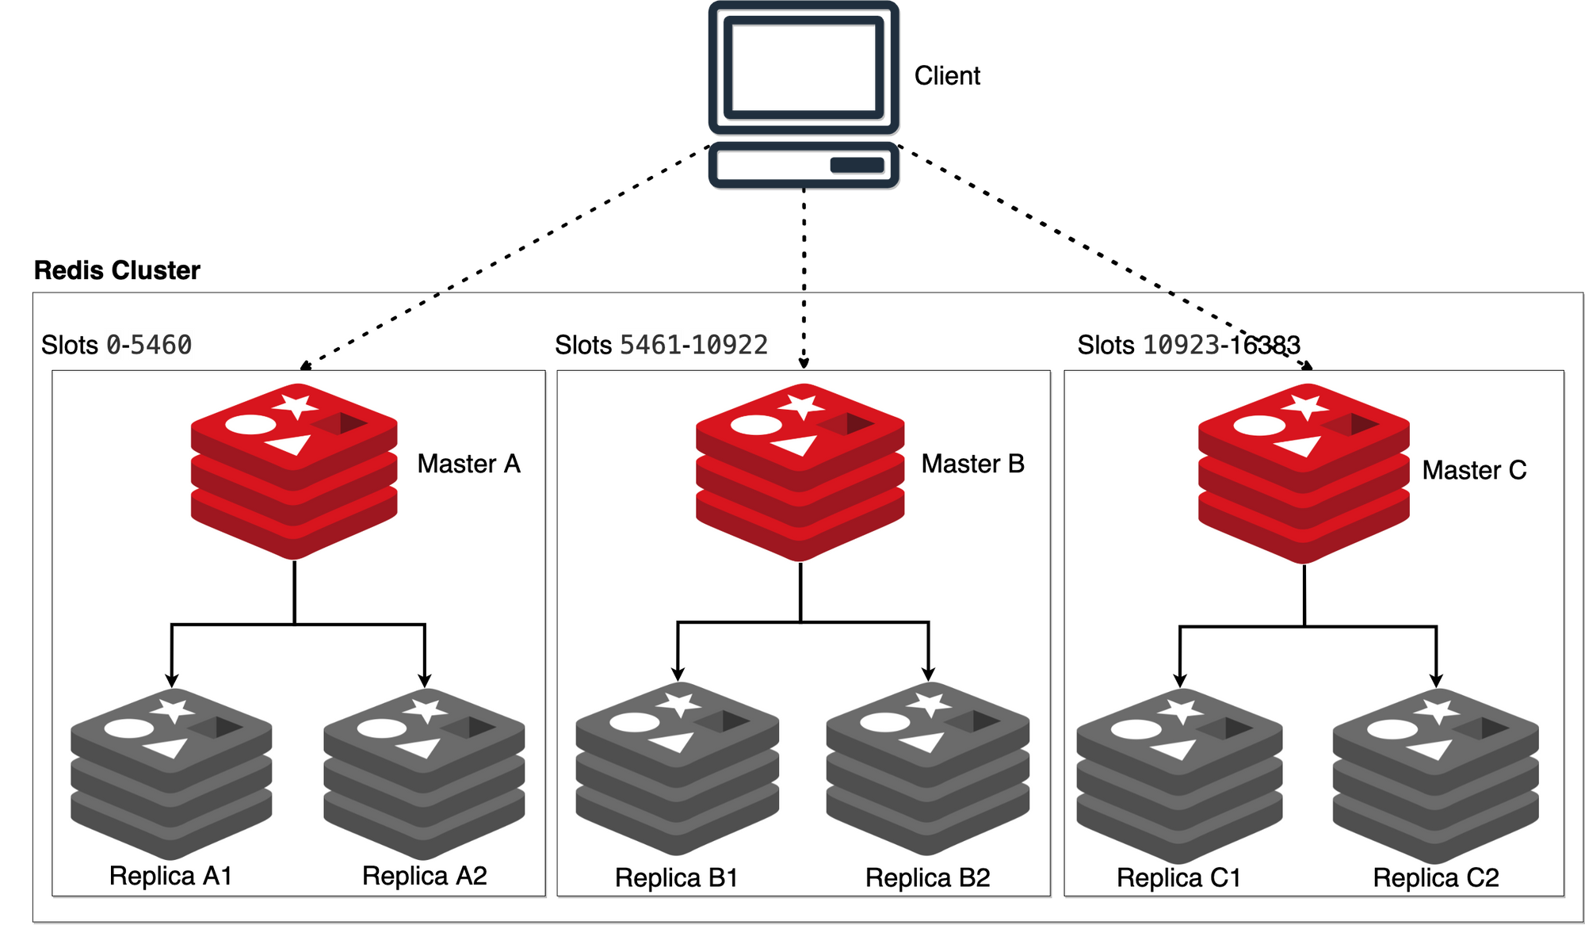
Redis
Clusters

Slide 10
Wide-Column
Structure
Row-key
Columns
Apollo
Duty
Color
Sun
Duty
weapon
Aphrodite
Love, happy
Sword
Duty
Ares
War
Dead Gods
13
Kratos
Notes:
https://ourworldindata.org/grapher/historical-cost-of-computer-memory-and-storage

Slide 11

Apache Cassandra
User Cases
Use Case | Description
Online Retail | Managing e-commerce platforms, handling product catalogs, user profiles, and transaction records.
Social Media Analytics | Monitoring and analyzing social media interactions, tracking trends, and user engagement.
Real-Time Analytics | Enabling quick analysis of data streams for instant insights, critical in financial and logistics sectors.
Logging and Monitoring | Centralized storage and analysis of logs and monitoring data from applications and servers.

Slide 12

Apache Cassandra
Cluster
R1
R4
1
2
R2
R5
12
1
2
3
12
3
Client
11
4
11
4
DC1
DC2
10
10
5
5
9
6
9
8
6
7
8
7
R3
R6

Slide 13

Document
Structure
{
"name":"Diana",
"duty":[
"Hunt",
"Moon",
"Nature"
],
"siblings":{
"Apollo":"brother"
}
}
Notes:
https://ourworldindata.org/grapher/historical-cost-of-computer-memory-and-storage

Slide 14

MongoDB
User Cases
Use Case | Description
Content Management | Store and manage diverse content types like articles, images, and videos with schema flexibility.
Catalog Management | Efficiently organize and categorize products or items with changing attributes and metadata.
Mobile Applications | Provide offline capabilities and sync data seamlessly once online, enhancing user experience.
Social Media Platforms | Facilitate rapid storage and retrieval of user-generated content, profiles, and social interactions.

Slide 15
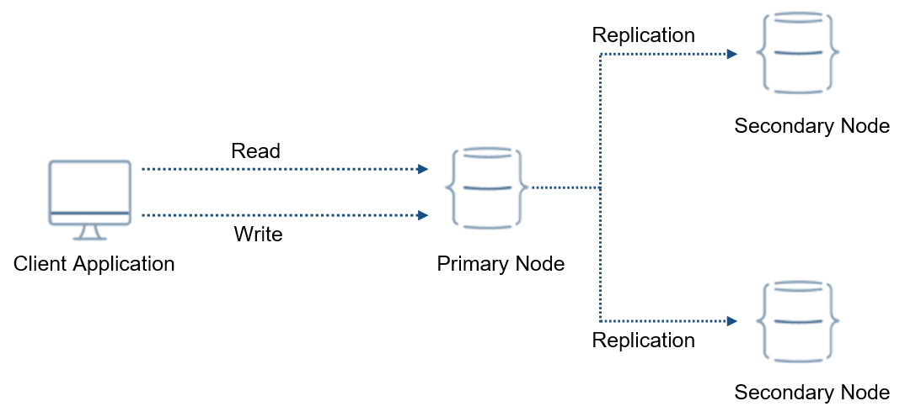
MongoDB
Cluster

Slide 16
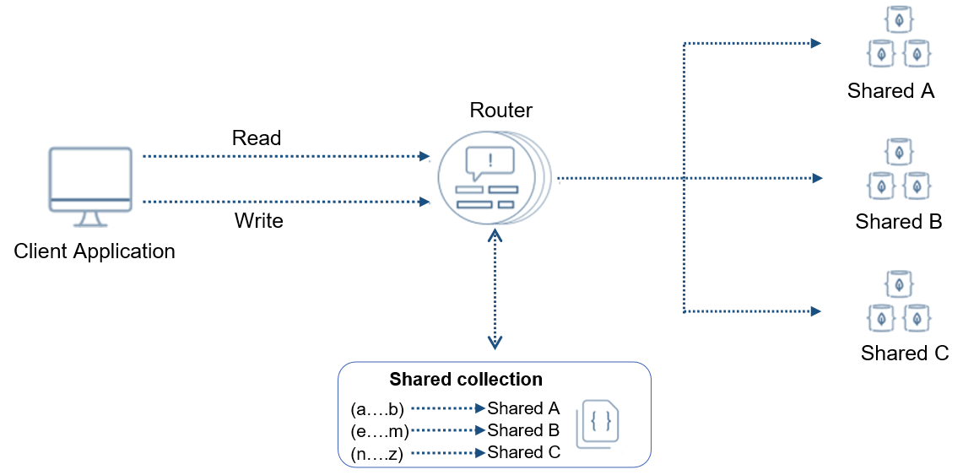
MongoDB
Cluster

Slide 17
Graph
Structure
Apollo
Ares
killed
killed
Kratos
was killed by
was killed by
Notes:
https://ourworldindata.org/grapher/historical-cost-of-computer-memory-and-storage

Slide 18

Neo4J
Read Replica
Leader
Follower
Follower
Read Replica

Slide 19
Neo4J
User Cases
Use Case | Description
Social Networks | Modeling user profiles, friendships, and interactions for effective social networking platforms.
Recommendation Engines | Powering personalized recommendations by analyzing connections and preferences.
Knowledge Graphs | Organizing and querying complex relationships in fields like healthcare, finance, and research.
Fraud Detection | Uncovering hidden patterns and connections indicative of fraudulent activities.
Network Analysis | Analyzing intricate relationships in data networks, such as transportation and communication.

Slide 20
Scalability vs Flexibility
Query and speed
key-value
Column
Scalability
Time-series
Document
Graph
Flexibility
Notes:
https://ourworldindata.org/grapher/historical-cost-of-computer-memory-and-storage

Slide 21
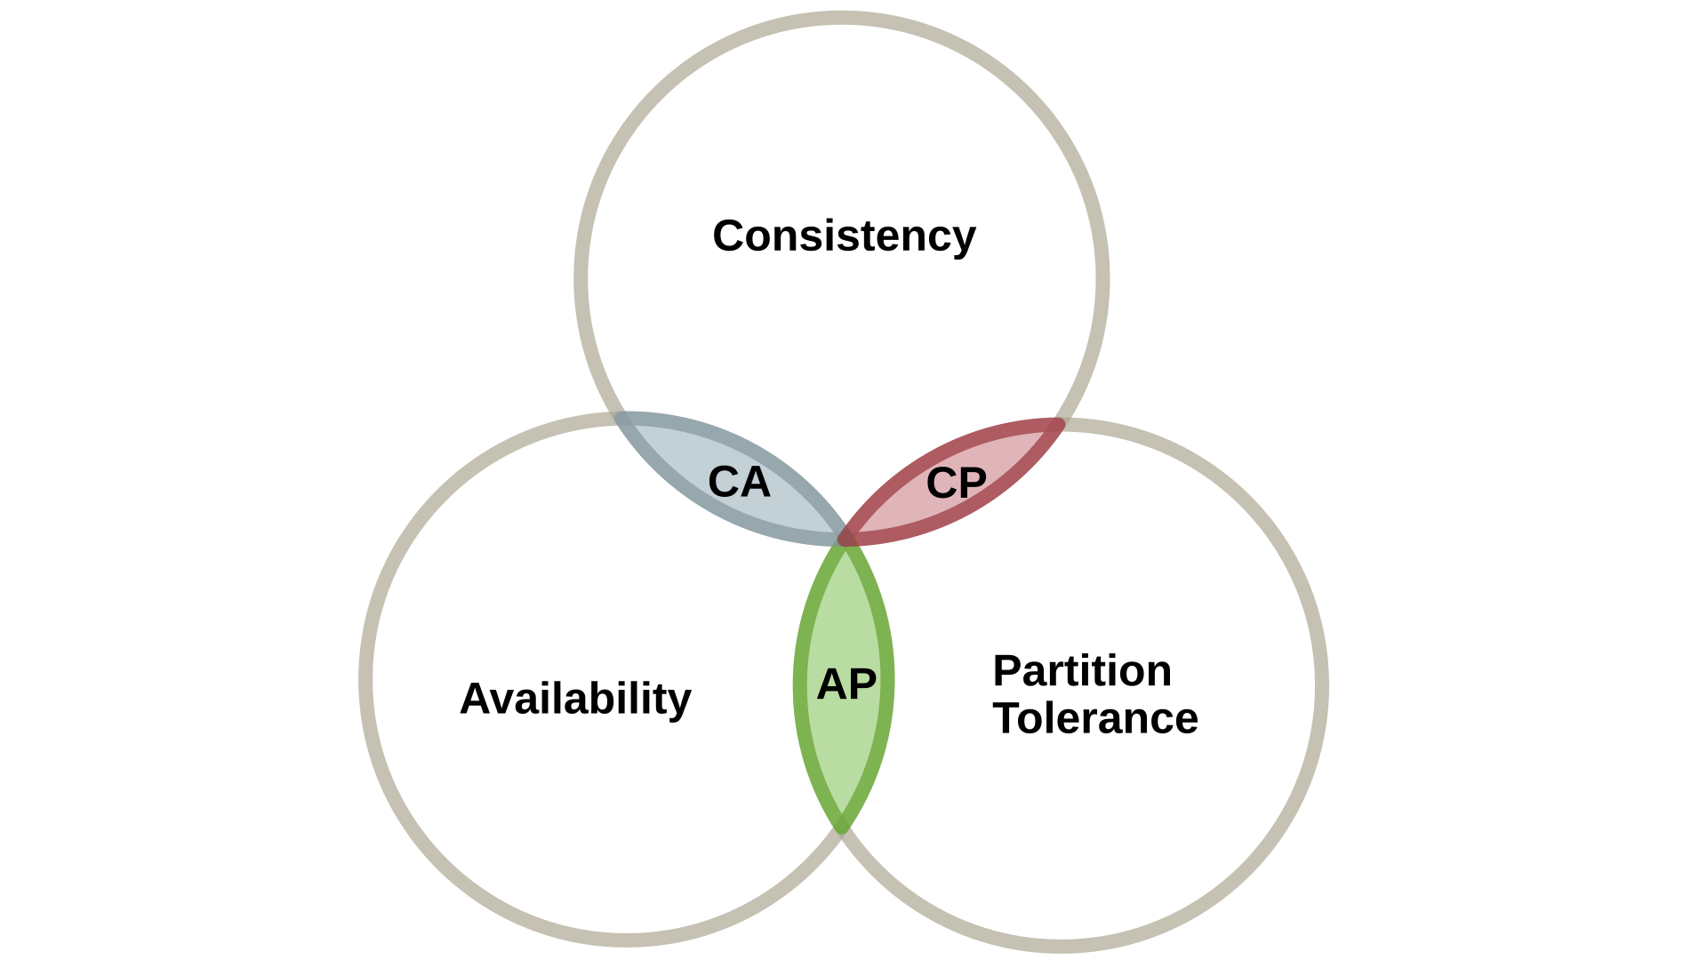






CAP
Distributed database and trade-offs
Notes:
https://ourworldindata.org/grapher/historical-cost-of-computer-memory-and-storage

Slide 22
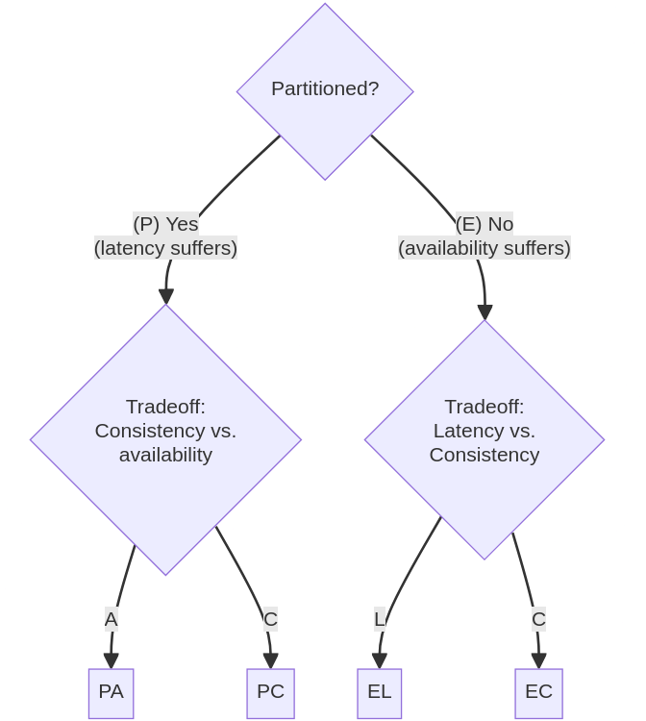
PACELC – Extending the CAP Theorem
What happens when the system is not partitioned?
PA/EL - prioritize availability and latency over consistency
PA/EC - when there is a partition, choose availability; else, choose consistency
PC/EL - when there is a partition, choose consistency; else, choose latency
PC/EC - choose consistency at all times
Notes:
https://ourworldindata.org/grapher/historical-cost-of-computer-memory-and-storage

Slide 23
Data Processing in Modern Architectures
From Raw Streams to Structured Analytics
Data Warehouse
Stores structured, clean, analytical data
Schema-on-write, optimized for SQL queries
Powers BI tools and dashboards
Not suitable for huge unstructured datasets
Data Lake
Stores raw, unstructured, and semi-structured data (JSON, images, logs, etc.)
Cheap, scalable, schema-on-read
Ideal for machine learning and big data analytics
Can turn into a “data swamp” if unmanaged
Notes:
Ingest – Capture data from sources (APIs, DBs, devices)
Store – Persist in raw or structured form
Process – Clean, enrich, transform
Analyze – Enable insights and decisions
Serve – Deliver to dashboards, ML, or APIs

Slide 24
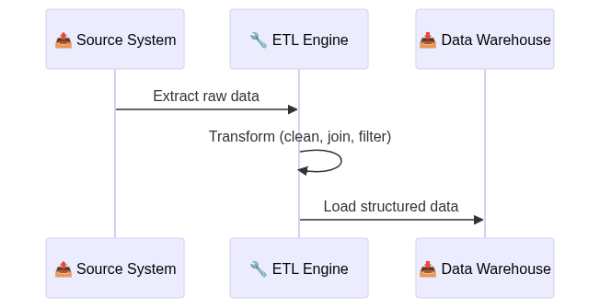
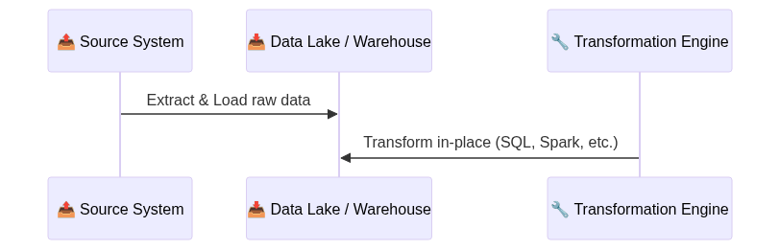
ETL vs ELT – Data Transformation Strategies
Moving, Cleaning, and Structuring Data at Scale
ETL – Extract, Transform, Load
ELT – Extract, Load, Transform
Notes:
Ingest – Capture data from sources (APIs, DBs, devices)
Store – Persist in raw or structured form
Process – Clean, enrich, transform
Analyze – Enable insights and decisions
Serve – Deliver to dashboards, ML, or APIs

Slide 25


Data Partitioning (Sharding)
How to Scale Databases Horizontally
What is Sharding?
Sharding is the process of splitting data across multiple machines (shards) to handle large volumes and high traffic.
📈 Scalability: Spread load across multiple nodes
⚡ Performance: Reduce latency by reducing dataset per node
🔄 Availability: One shard down ≠ full system down (if well-designed)
Monolithic DataBase
Shard
Shard
Shard
✅ Scalability
✅ Improvied performance
✅ Availability
Notes:
Ingest – Capture data from sources (APIs, DBs, devices)
Store – Persist in raw or structured form
Process – Clean, enrich, transform
Analyze – Enable insights and decisions
Serve – Deliver to dashboards, ML, or APIs

Slide 26
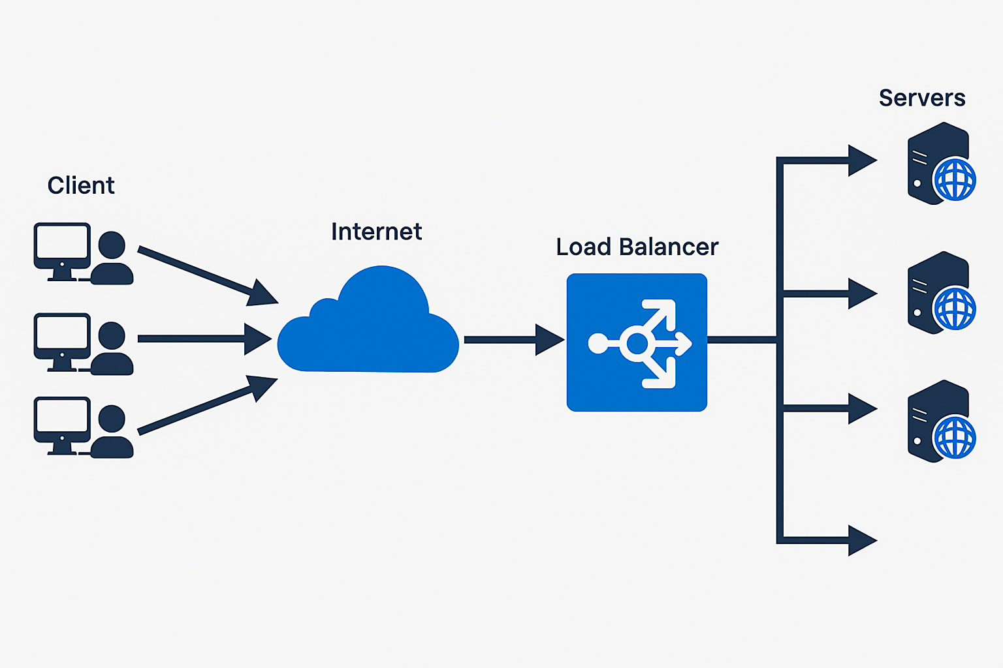
Load Balancer
Distributing Traffic for Scalability and Reliability
⚖️ Distributes load to avoid bottlenecks
🔁 Increases availability by rerouting traffic if a server fails
📈 Scales horizontally by adding/removing instances easily
🔐 Can handle SSL termination, caching, health checks
Notes:
Ingest – Capture data from sources (APIs, DBs, devices)
Store – Persist in raw or structured form
Process – Clean, enrich, transform
Analyze – Enable insights and decisions
Serve – Deliver to dashboards, ML, or APIs

Slide 27
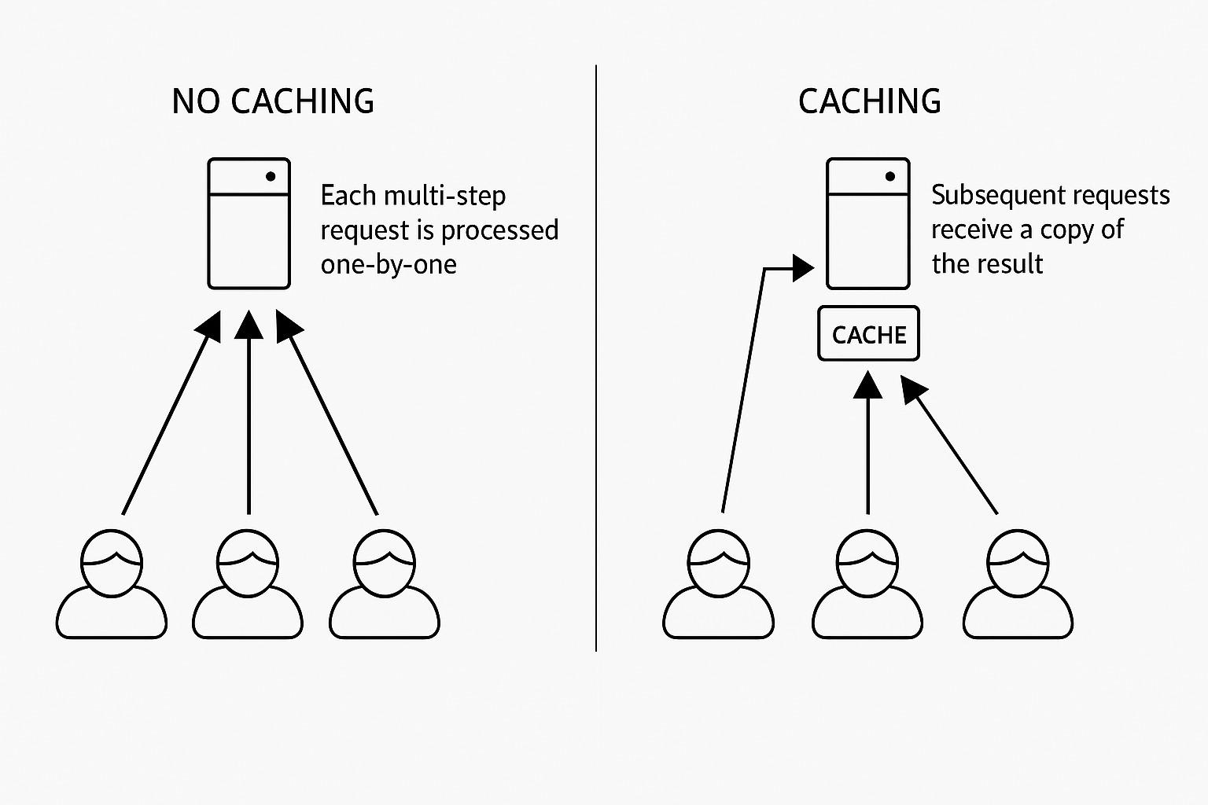
Caches
Speeding Up Systems by Reducing Repetition
Faster responses (lower latency)
Reduces load on databases and APIs
Improves scalability by offloading repeated work
Notes:
Ingest – Capture data from sources (APIs, DBs, devices)
Store – Persist in raw or structured form
Process – Clean, enrich, transform
Analyze – Enable insights and decisions
Serve – Deliver to dashboards, ML, or APIs

Slide 28
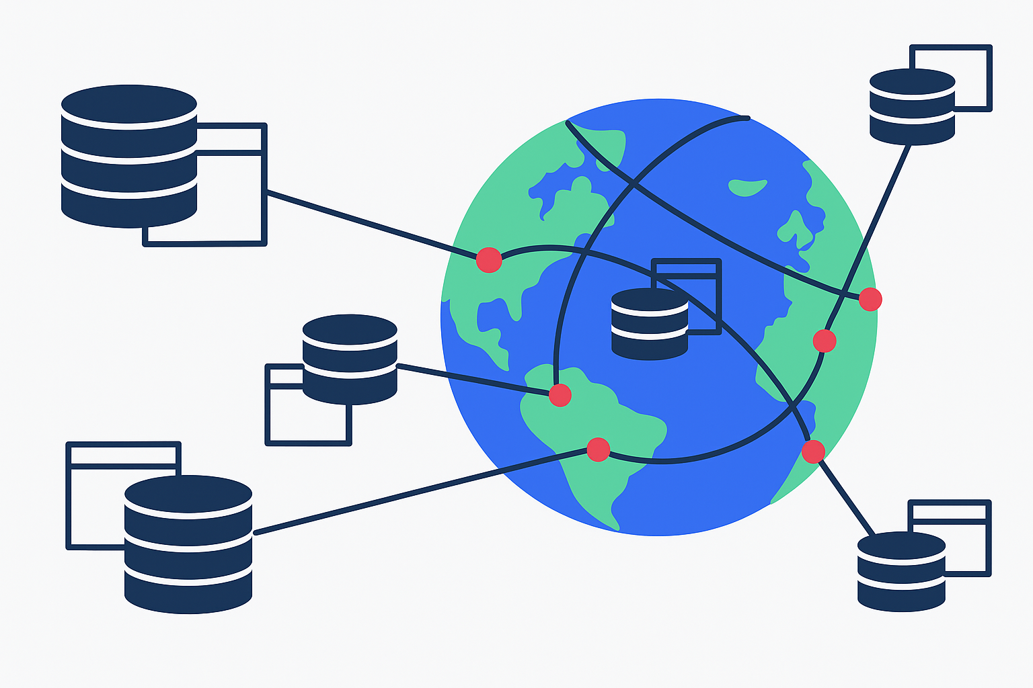
Distributed Databases & Replication
Scaling Data with Redundancy and Reach
Notes:
Ingest – Capture data from sources (APIs, DBs, devices)
Store – Persist in raw or structured form
Process – Clean, enrich, transform
Analyze – Enable insights and decisions
Serve – Deliver to dashboards, ML, or APIs

Slide 29
Masterless
Database replication
Notes:
https://ourworldindata.org/grapher/historical-cost-of-computer-memory-and-storage

Slide 30
Master-slave (leader-follow)
Database replication
Notes:
https://ourworldindata.org/grapher/historical-cost-of-computer-memory-and-storage

Slide 31
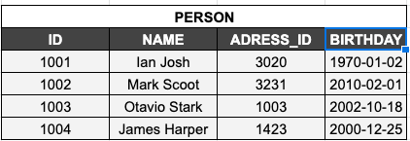
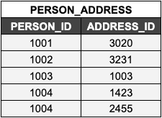
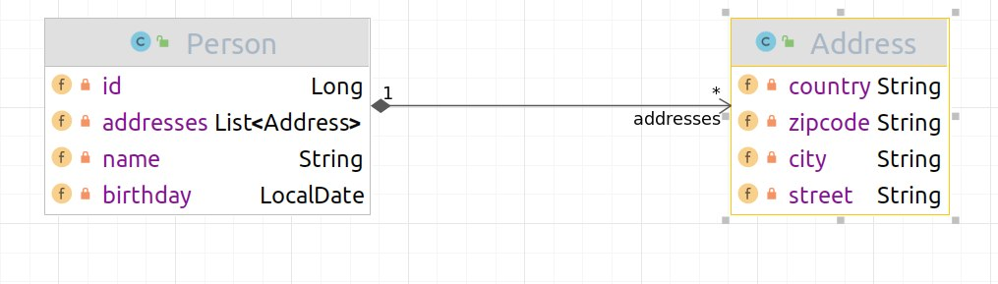
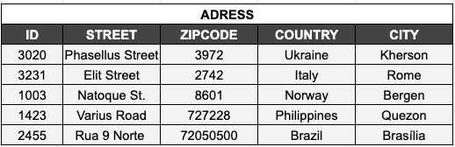
Challenges in a database land
Different paradigms: Apps x DBMS
Application
(Object Oriented Language)
Database
(Relational)
Mismatch
Object
Tables
Notes:
Object
Heritage
Polymorphism
Encapsulation
Types
Database Normalization
Denormalization
Structure

Slide 32
Challenges in a database land
Different paradigms: Apps x DBMS
Application
Database
wide-Column
Graph
1
Mapping Mismatch
*
Addresses
Document
Key Value
key
value
key
value
Inheritance
Polymorphism
Encapsulation
Types
key
value
key
value
Normalization
Denormalization
Structure
Notes:
Object
Heritage
Polymorphism
Encapsulation
Types
Database Normalization
Denormalization
Structure

